Slide 1

MLDE2021 Spring Semester
Project 2022
12.04.2022
RESLA
Juhani Vanhatapio, Tuomas Pasanen, Makarov Nikita, Adewunmi Obajimi,
Vincenzina Soös

Slide 2
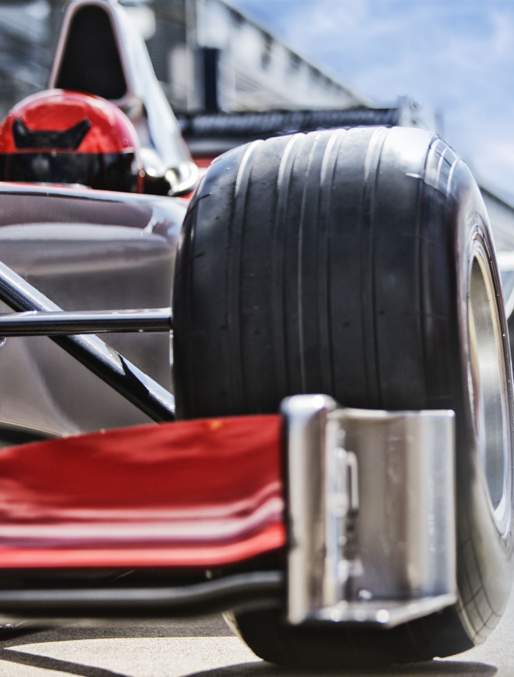
Background
Ensure the RC car moves
Driving via IoT, Bluetooth, ESP32 and Raspberry pi
Controlling via webpage
Testing

Slide 3
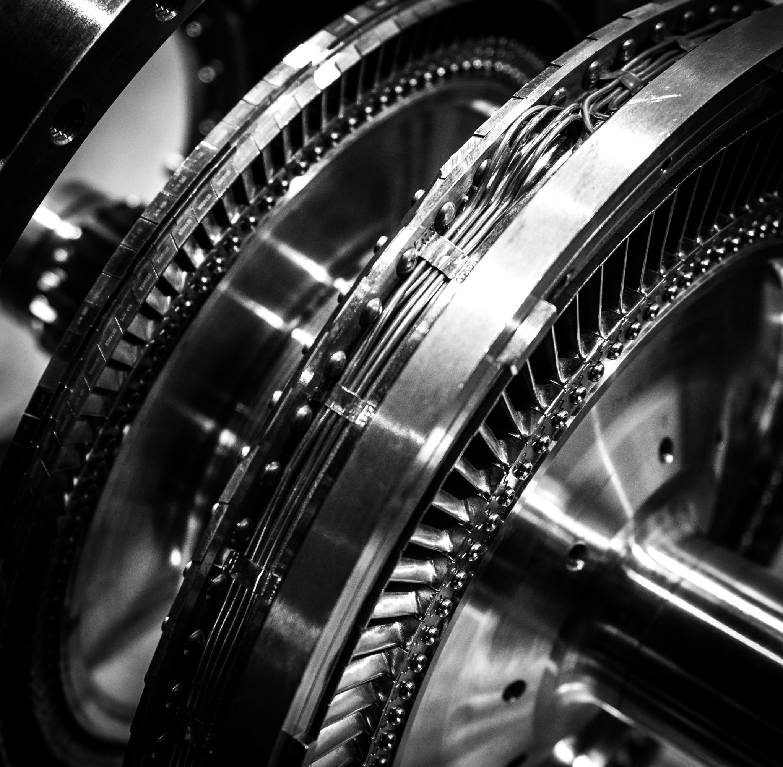
Hardware
Components
Power bank
Battery
Raspberry pi
RC Car
Software
Components
Python language
Flask library
RasPi standard library
HTML/CSS/Javascript

Slide 4
Actions
RC car can steer left and right, through the website
Planned features: Going forwards and backwards

Slide 5
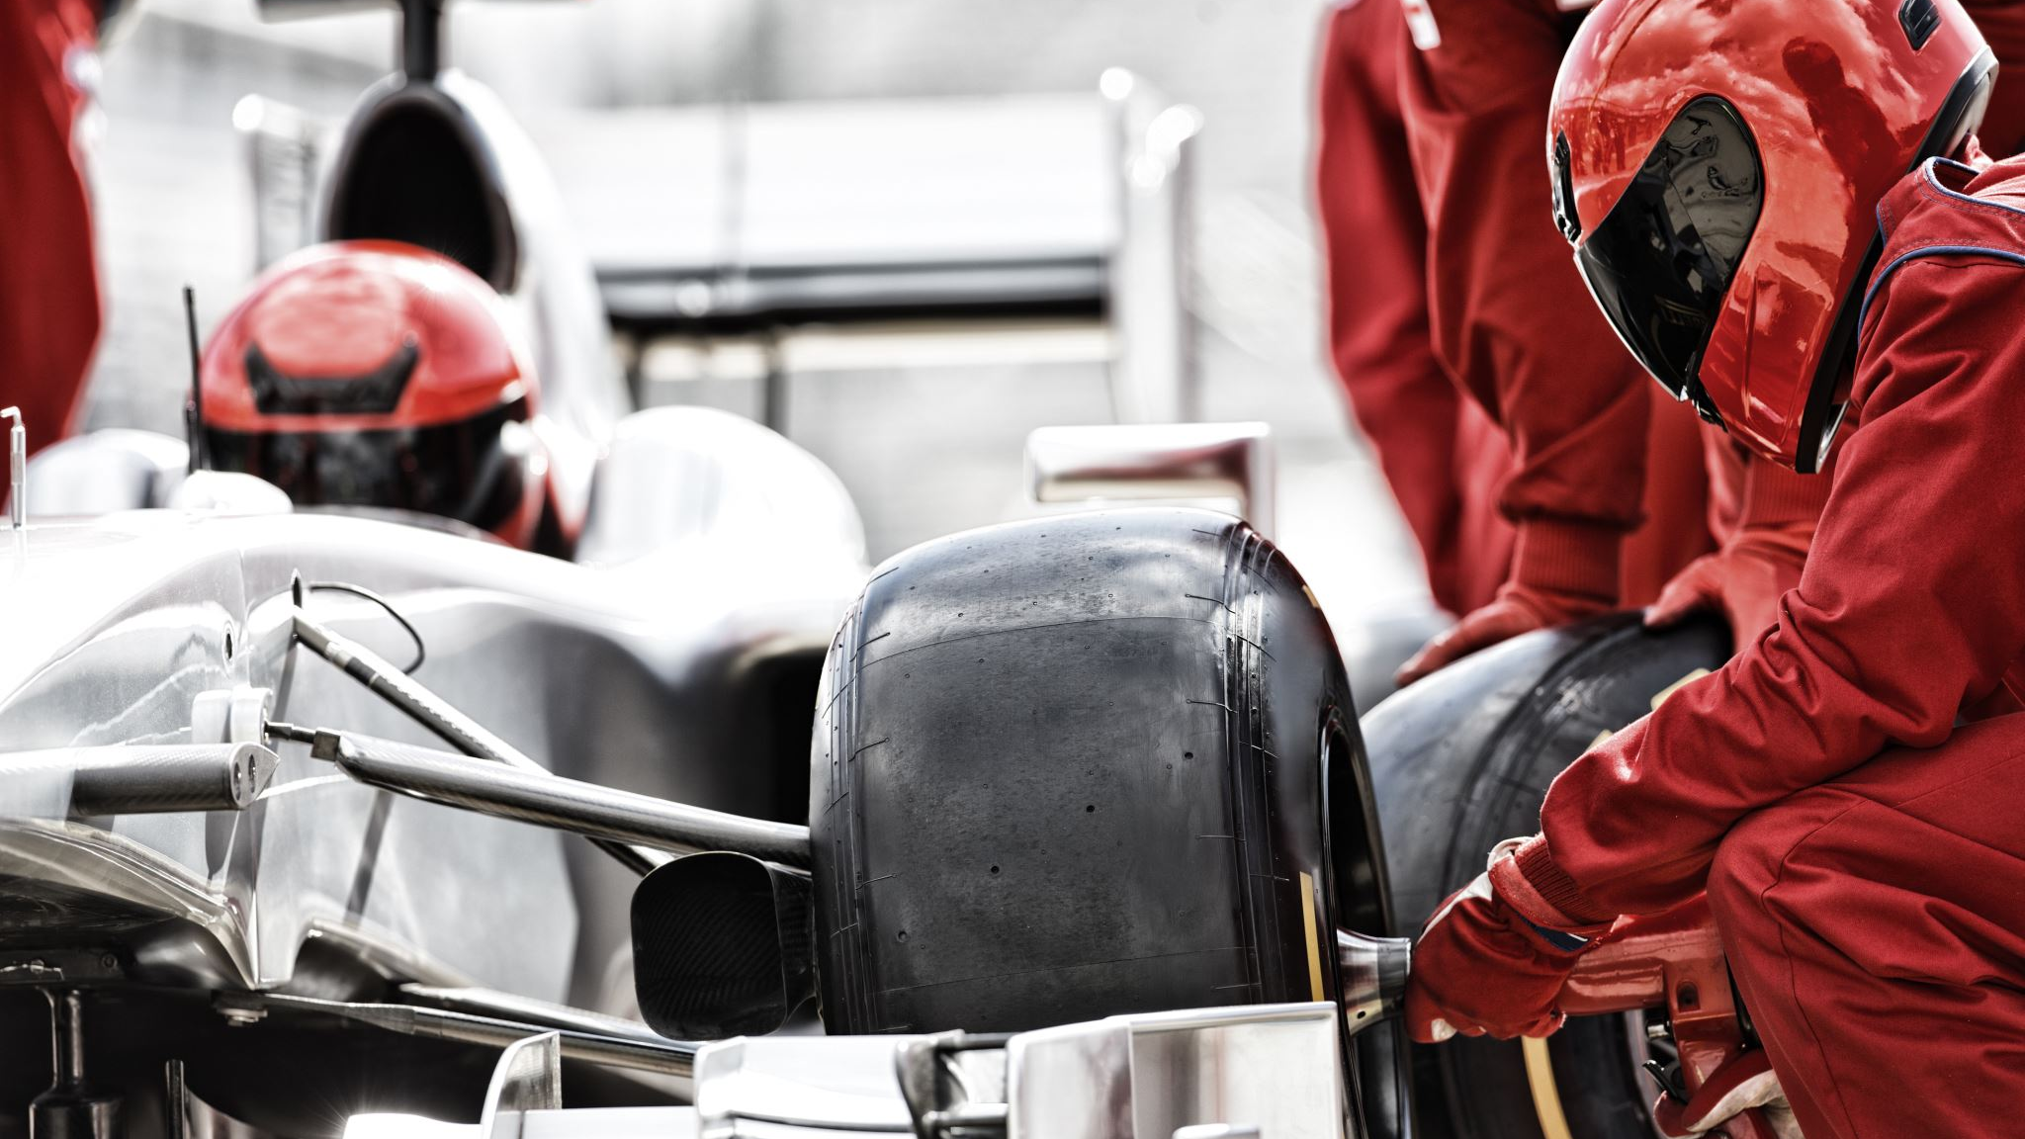
Driving The RC Car
Car controls can be called from the command line or WebPage.
Controls are written in Python3

Slide 6
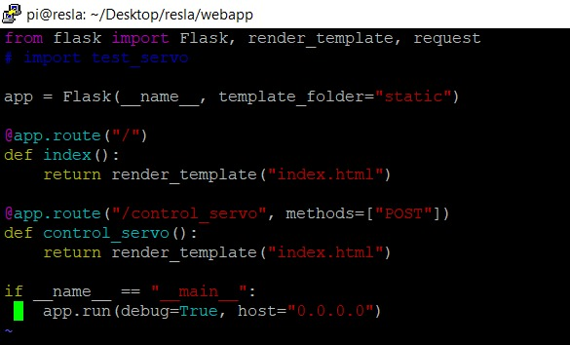

Slide 7
